Slide 1

AVERY DENNISON Assignment
Movie
Money Maker
A business proposal presentation

Slide 2
Executive Summary: Removing Intuition from Film Financing
THE CHALLENGE & PROPOSAL
The cinematic landscape relies heavily on high-risk, intuition-based investments. This proposal outlines a fully data-driven blueprint for profitable film projects.
DATA-DRIVEN DECISION PIPELINE
STEP 01
Raw Market Data
3,000+ films analyzed with social & global financial metrics
METHODOLOGY
We trained an advanced Machine Learning engine on over 3,000 top-grossing films, enriching historical baselines with real-time social metrics and updated global financial data.
STEP 02
Predictive AI Engine
Machine Learning model trained to eliminate intuition-based bias
KEY FINDING
Stop chasing oversaturated Drama and Comedy markets. The data explicitly points to Animation and Sci-Fi/Adventure, produced in the $40M–$100M budget range, as the ultimate vessels for maximizing returns.
STEP 03
Optimized Strategy
To target maximum revenue & systematically secure ROI > 150%
BUSINESS OUTCOME
By replacing guesswork with algorithmic validation, the studio can systematically achieve Returns on Investment (ROI) exceeding 150%, securing massive profit margins before a single dollar is spent on production.

Slide 3
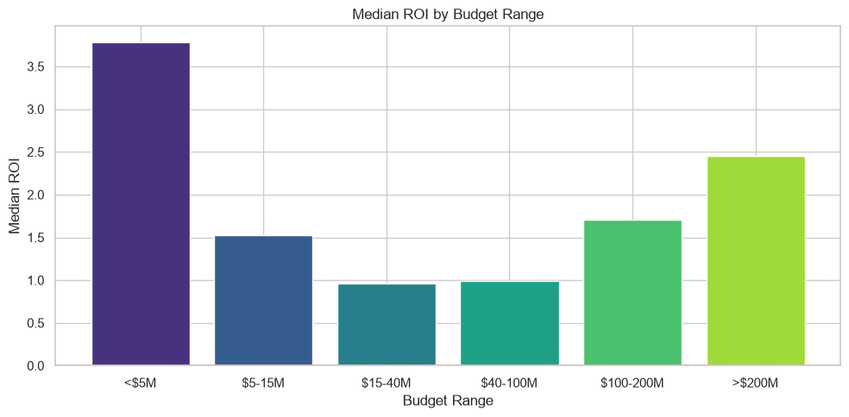
Capital Allocation: The $40M–$100M Risk-Adjusted Sweet Spot
UNDER $5M BUDGET
Films under $5M yield the highest pure percentage ROI (nearly 4x) due to incredibly low exposure, but they fail to scale to blockbuster revenue levels.
MEDIAN ROI BY BUDGET RANGE
$40M – $100M BUDGET
Budgets between $40M - $100M offer the most optimal balance. They provide sufficient scale for global marketing without catastrophic downside risk. This budget serves as a SWEET SPOT.
OVER $100M BUDGET
To capture billion-dollar market ceilings, capital investments exceeding $100M are mathematically required, though they carry exponentially higher financial exposure.

Slide 4
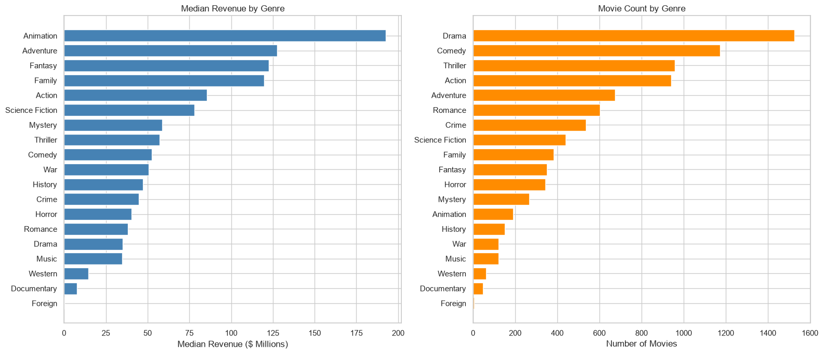
Market Saturation: Animation Dominates Financial Returns
THE TRAP OF OVERSATURATION
• Dramas & Comedies
Dramas and Comedies are vastly overproduced. They represent the most crowded markets but yield the lowest median revenues.
MEDIAN REVENUE & MOVIE COUNT BY GENRE
THE BLUE OCEAN
• Animation & Sci-Fi
Animation and Sci-Fi/Adventure represent clear high-yield opportunities that remain significantly less crowded than live-action counterparts.
THE INSIGHT
★ Massive Market Gap
Animation delivers the highest median return in the industry (approaching $200 million) while remaining structurally undersupplied by major studios, representing a massive market gap.

Slide 5
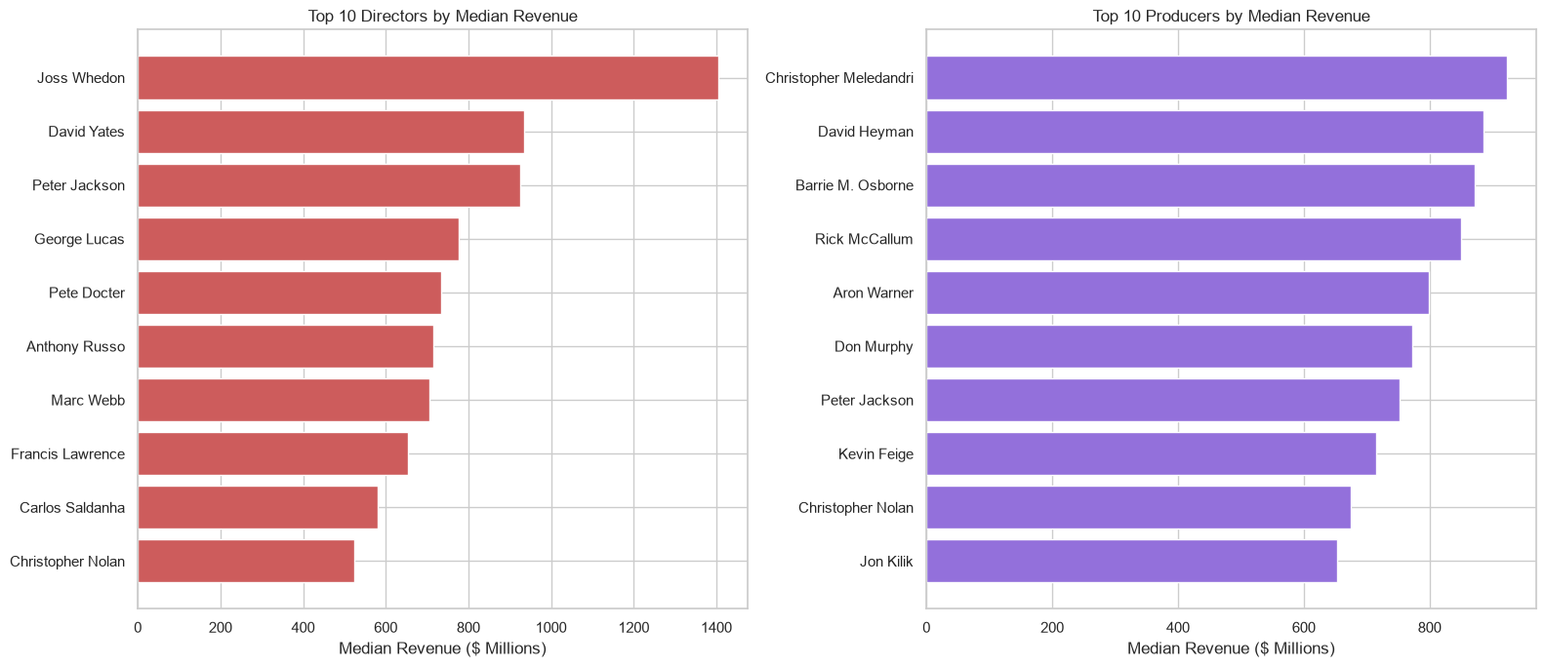
The Talent Multiplier: Producers Ensure Consistency
DIRECTORIAL PEAKS
• Franchise Ceilings
Visionary directors (e.g., Joss Whedon, David Yates) command the highest overall median revenues, proving their ability to execute massive, high-ceiling blockbuster events.
TOP TALENT BY MEDIAN REVENUE
THE PRODUCER'S PREMIUM
★ High Baseline & Consistency
While star directors can generate massive, unpredictable spikes, elite producers maintain a remarkably high, reliable financial baseline across multi-film portfolios.
RECOMMENDATION
• Track Record Risk Assessment
Prioritize producer track records over director acclaim when assessing a project's financial risk.

Slide 6
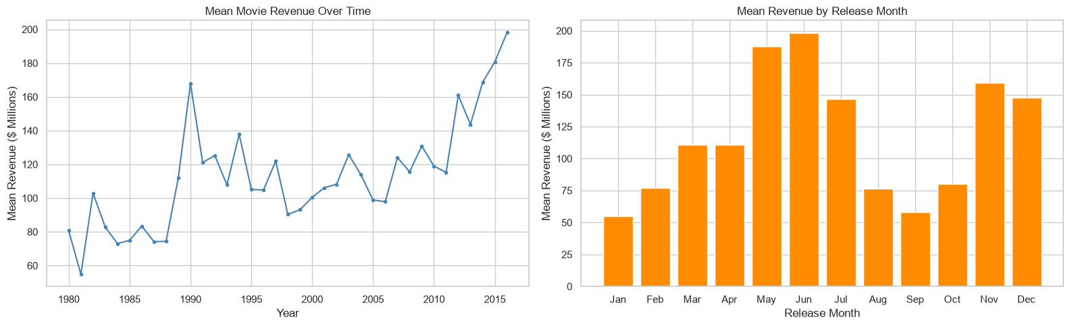
Structural Scale: Timing and Pre-Release Demand
STRATEGIC WINDOWS
• Peak Consumer Spending
Global consumer spending peaks drastically during two distinct corridors: the Summer Blockbuster season (May–June) and the Holiday season (Nov–Dec).
MEAN REVENUE BY RELEASE MONTH
FORMAT PARAMETERS
★ Revenue Expansion
Runtimes between 120-150 minutes significantly expand global reach and revenue caps.
HYPE DICTATES SCALE
• Pre-Release Demand
Pre-release popularity metrics account for the vast majority of our revenue predictability, emphasizing the need for front-loaded marketing campaigns.

Slide 7
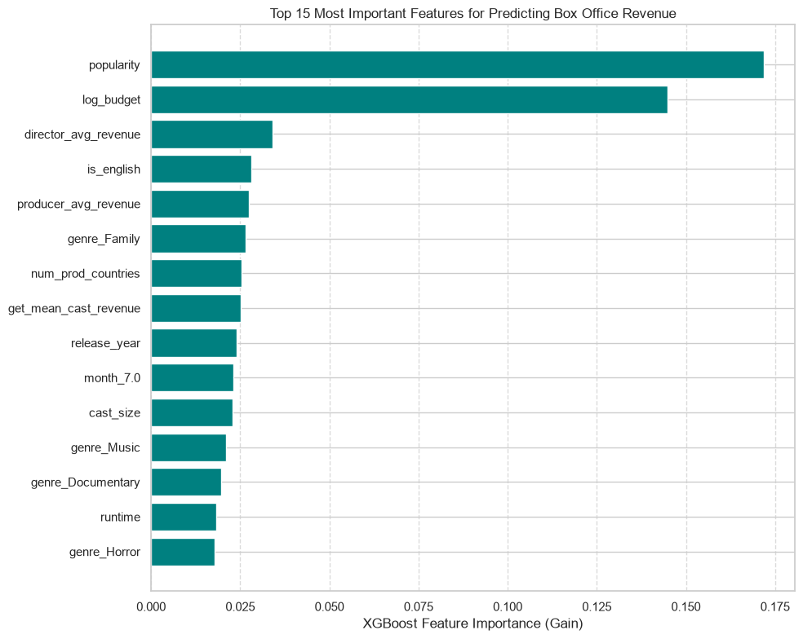
Algorithmic Validation: Our XGBoost Predictive Engine
ML ENGINE ARCHITECTURE
• Non-Linear Pattern Recognition
To ensure insights are actionable, we engineered a Machine Learning engine (XGBoost Regressor) trained to identify complex, non-linear relationships in film production data.
FEATURE IMPORTANCE CHART
FEATURE ISOLATION
★ Core Data Drivers
By isolating pre-release popularity, structured budget scale, and historical talent performance, the system isolates high-impact success variables.
PRE-PRODUCTION FORECAST
• Revenue Simulation
Allows us to input a hypothetical movie's parameters and output a highly accurate revenue forecast before production begins.

Slide 8
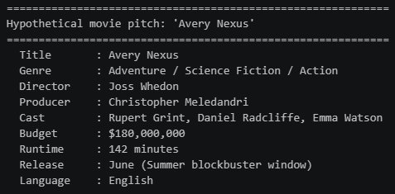
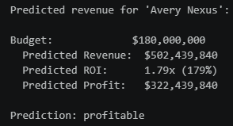
Applied Strategy: Hypothetical Project 'Avery NEXUS'
We designed a theoretical film project calibrated to trigger our algorithm's highest success indicators:
CONCEPT MOVIE PREDICTION
CORE PARAMETERS • Film Specifications
GENRE & CONCEPT
Sci-Fi / Action / Adventure
English Language
BUDGET ALLOCATION
$180,000,000
TARGET RELEASE
June Release Window
Prime Summer Blockbuster
RUN-TIME DURATION
142 Minutes
TALENT ROSTER
★ Attached Talent
DIRECTOR
Joss Whedon
Action & Sci-Fi Visionary
PRODUCER
C. Meledandri
High-Track Record Producer
STAR CAST
Daniel Radcliffe
Emma Watson
Rupert Grint

Slide 9
Financial Forecast: Project Avery NEXUS ROI
Applying the parameters of Project NEXUS to our predictive model yields the following mathematically validated forecast:
BOX OFFICE REVENUE
$502.4M
Forecasted Global Box Office Revenue ($502,439,840)
PURE PROFIT
$322.4M
Projected Pure Profit after production and marketing expenses
ESTIMATED ROI
179%
Estimated Return on Investment based on predictive model calibration
STRATEGIC VERDICT
Verdict: Avery NEXUS represents a highly profitable asset that aligns perfectly with our optimal risk-adjusted strategy.

Slide 10

Answering Assignment Questions
OPTIMAL GENRE
What genre of film (thriller, adventure, romantic,...) should you create to make sure you make the most money?
Ans: Animation is the clear winner. It shows the highest median return (around $192.5M). It's also less crowded than heavily saturated genres like Drama or Comedy, making it a great market to target.
STAR TALENT
Who are the top 3 actors you should hire to make sure you make the most money?
Ans: Based on my data analysis casting Rupert Grint, Daniel Radcliffe, and Emma Watson. The real, practical takeaway here is that casting leads with a built-in, dedicated fandom (or tying them to a massive IP) is one of the safest bets for high box office returns.
CREATIVE LEADERSHIP
Which film director and film producer should you hire to make sure you make the most money?
Ans: Joss Whedon tops the list for directors (with a median revenue of $1.4B), and Christopher Meledandri is the top producer ($923M). The data shows that top producers tend to be much more consistent for hits across their careers compared to directors, whose box office numbers can vary wildly from film to film.
CAPITAL & ROI OPTIMIZATION
How should you spend to produce the movie to optimize ROI?
Ans: It depends on how you measure success. Analysis shows that for the best risk-adjusted returns, a budget between $40-100M is the sweet spot. If you just want the biggest possible absolute total gross, you have to spend big (over $100-200M). That said, micro-budgets (under $5M) actually give the highest percentage ROI (median 3.78x) simply because they are so cheap to make—they just won't pull in blockbuster-level cash.
KEY IMPACTFUL PARAMETERS
Any other impactful parameters you want to include
Ans: Budget and pre-release popularity scores are the biggest predictors of a movie's final scale. Beyond that, timing is everything like releasing during the summer or the holiday season gives a big bump. Runtimes hitting that 120-150 minute sweet spot, having a large crew, and filming in English for global distribution also consistently drive up revenue.

Slide 11
Thank you

